Slide 1
Detection & Decoding of QRCODE using OpenCV Python
Neha Jaiswar (23-SE-E&TC-A)
Riya Gupta(15-SE-E&TC-A))
Rohit Pal (46-SE-E&TC-A)
Aniket Vishwakarma (50-FE-COMPS)
Amrita Gupta (51-FE-COMPS)
Vrushti Gangwal (46-FE-COMPS)

Slide 2
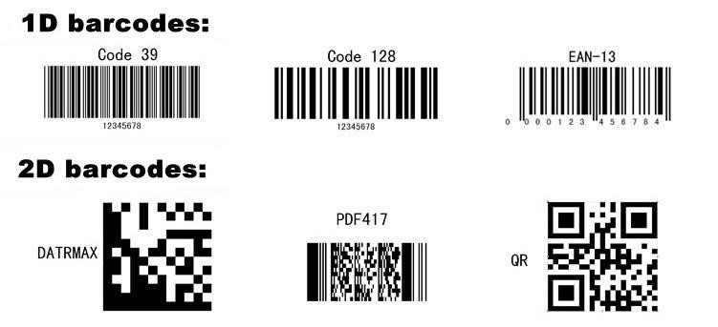
Understanding Problem
Labels which contain QRCode may appear different by depending upon on types of illumination, angle and orientation.
Detection based on feature characteristics of QRCode, distance, angles, resolution and brightness in the original images is quite a big challenge.
Main Focus of this project :
Detection of different kinds of labels and this is to realize an image for QRCode detection in the real environment which is flexible to face the real life problems.

Slide 3
Introduction
Being a customer(consumer) , the concept of barcode and barcode scanner machine is very much familiar. As for purchasing from any retail stores, malls, renting a car, major events, in the airport, and sometime even going to the doctor.
QR codes are also used in social media apps, best example is whatsapp-web . A barcode is basically an optical, machine readable representation of data(information) which describes about the object that carries the barcode. It is basically a visual description of data in the form of bars and spaces.
Earlier barcodes systematically represents information by changing the widths and the spacing of parallel lines, is also known as one dimensional(1D). Then , two dimensional (2D) barcodes were developed containing rectangle dots, boxes, hexagons and other geometric shapes, called as 2D or matrix barcode, but they do not contain bars.
Earlier, barcode could be scanned by some special optical scanner machine. But now, the supermarket or stores have hand held scanners which is able to automatically scan the barcodes.
In this project, work was done on barcodes to detect them from various products having better efficiency and accurate result. Now a days, cell phones or digital cameras are present everywhere and it is also cheap as compared to hand held barcode scanners. So, implementing this project in various devices like mobile phones will be much more cost efficient.
Barcode technology is the main pillar of the automatic identification which can be used in some real time applications with many types of codes.

Slide 4
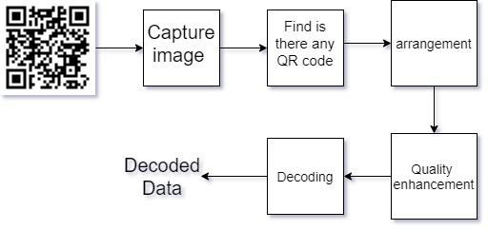
Architecture and Block Diagram
Basically QR code detection is very simple process in first we get a QR code from any devices such as your video for video capturing devices and your phone's camera.
Then algorithm is detecting weather in that image or video you have that QR code if it is then it will be decoding data.
If not, then it will be applied algorithm to find the rectangle and check the weather for 3 points of the QR code is present on that picture if it is present that it will be crop that image and decode the data from that QR code. After that you can use your decoded data to use wherever you like.

Slide 5
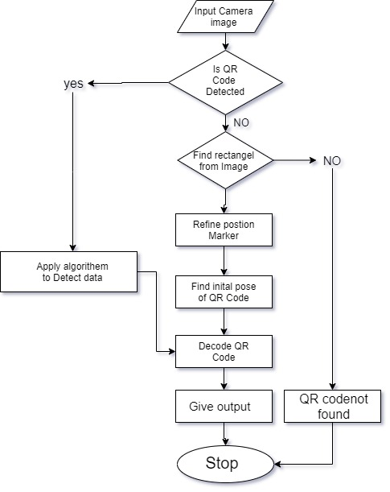
FLOWCHART
We detect and decode the data of QRCode
using 3 different inputs which includes preloaded
image, preloaded video and the live video using
webcam.
So in this flowchart firstly the input is given which
can be any one among the above mentioned
input methods and then the function detected
whether there is QRCode.
If the QRCode was found it apply the decode
function and if not, then it finds the barcode using
rectangle method and further the decode functio
-n gives the decoded output. Finally, the final
output is displayed.

Slide 6
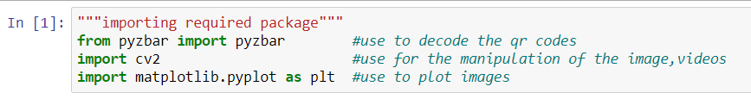
Implementation
Algorithm: -
We will be using OpenCV to scan and to decode the barcodes we need extra library i.e. Zbar Library. In our project we have divided our whole project into 4 parts
For scanning the QR Code in image
For scanning QR Code in Recorded Video
For Scanning QR Code through webcam(live)
For checking Authorized or Unauthorized entry
Step 1. Importing Required Package

Slide 7
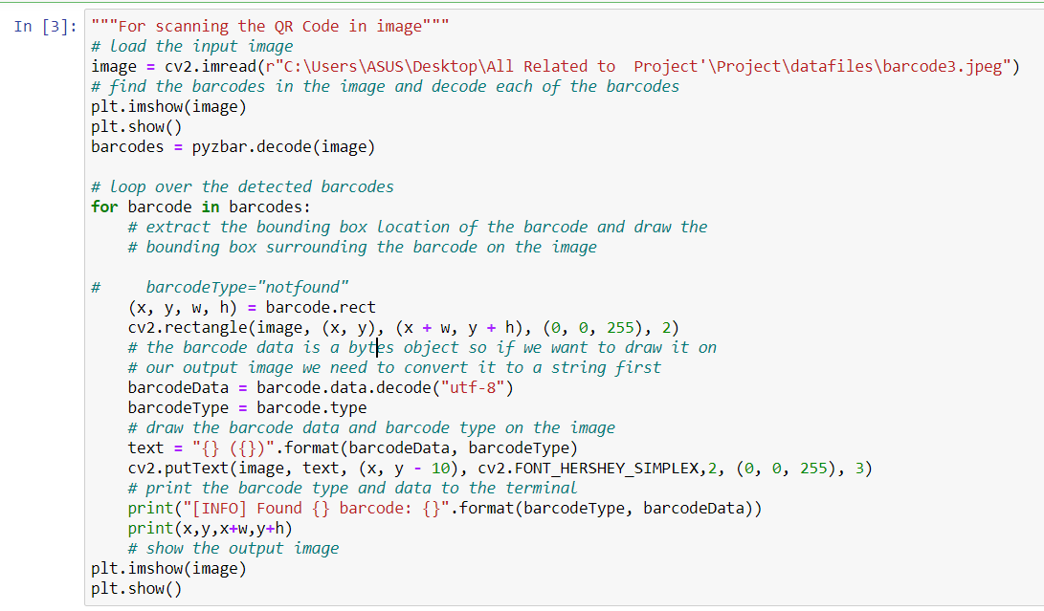
Implementation(contd.)
For scanning the QR Code in pre-loaded image

Slide 8
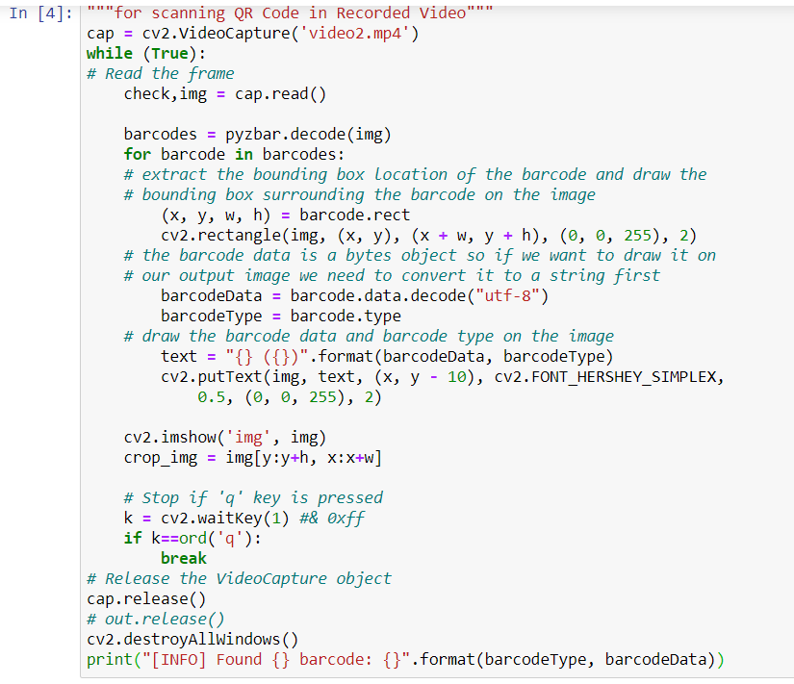
Implementation(contd.)
For scanning the QR Code in pre-loaded video

Slide 9
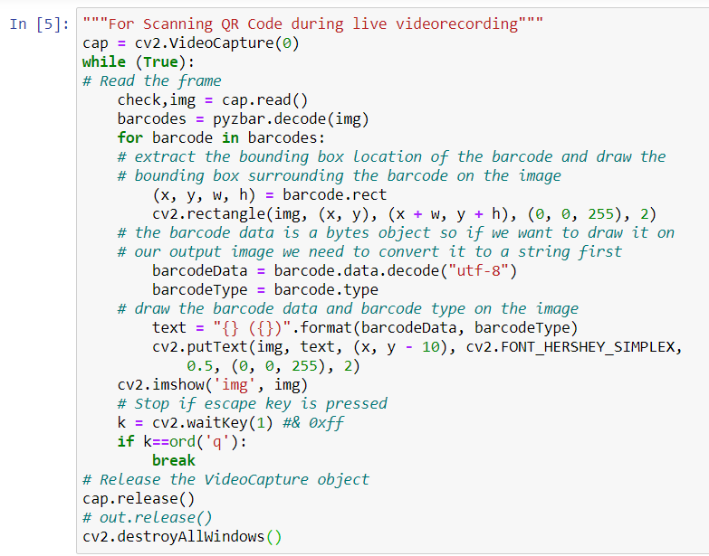
Implementation(contd.)
For live video

Slide 10
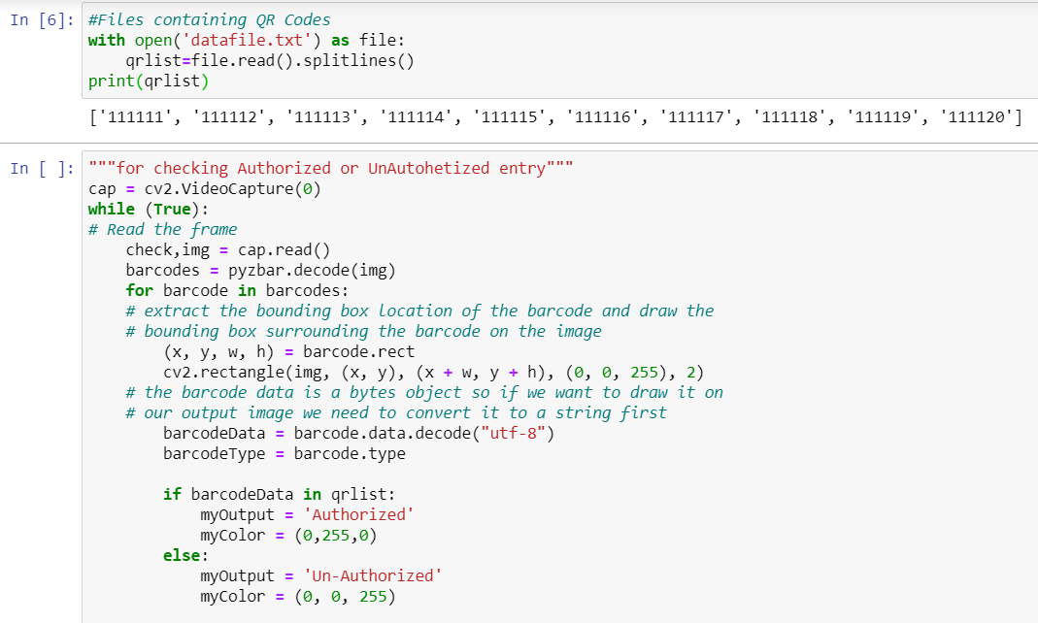
Implementation(contd.)
To check Authorised and Unauthorised

Slide 11
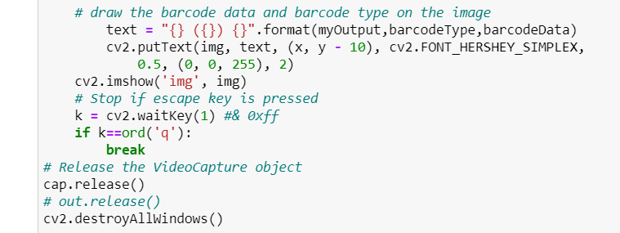
Implementation(contd.)

Slide 12
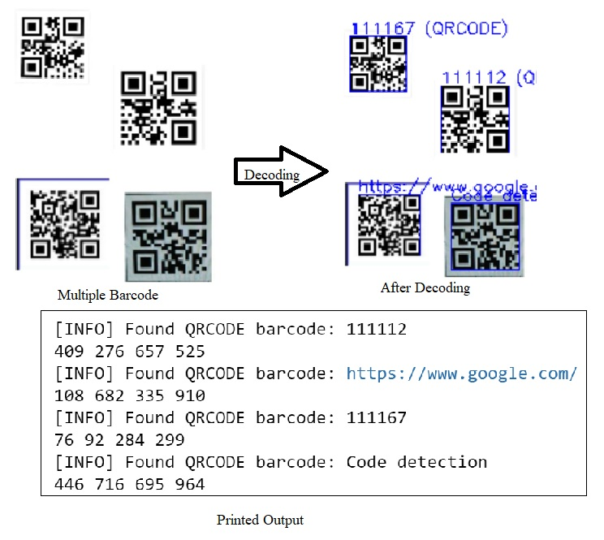
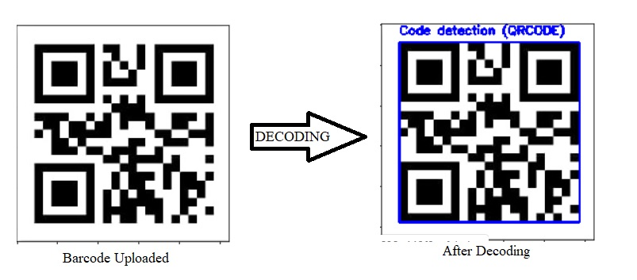
Result and Discussion
We divided our project into 4 parts and obtained the desired result. Thereby I will be discussing results of all the parts.
For scanning the QR Code in image
fig. Using Multiple Barcode fig. Using One Barcode

Slide 13
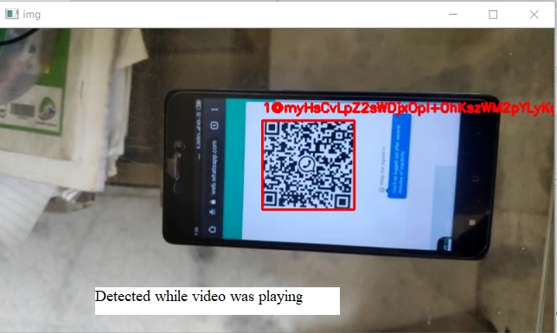
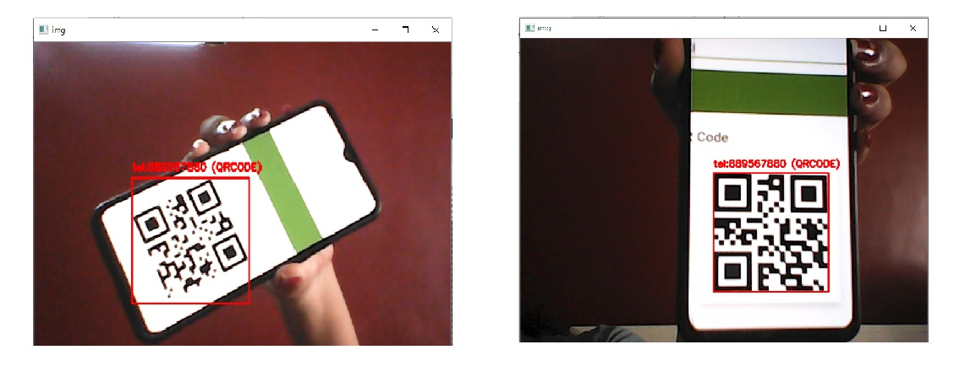
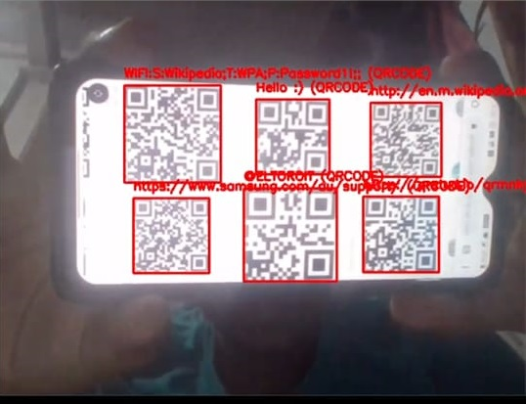
Result and Discussion(contd.)
For scanning the QR code in pre-recorded video
For scanning the QR code in live video

Slide 14
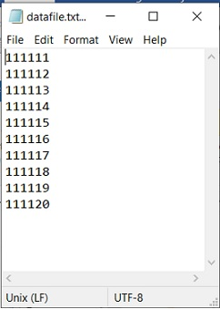
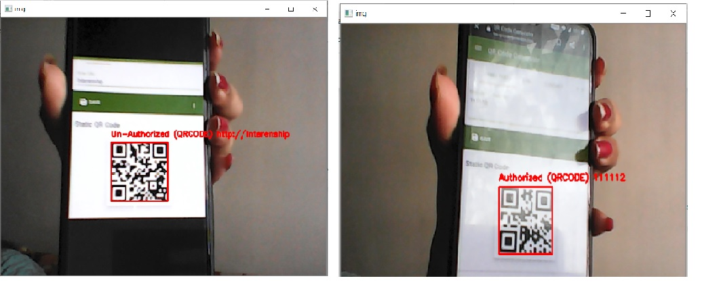
Result and Discussion(contd.)
To check whether the QR Code is Authorised or Unauthorised
In this part we uploaded a dataset (i.e. a text file with data particular numbers which can be presented as authorised employee number).
The accuracy of our model is 96.433.
fig. Dataset (.txt file) fig. whether the QR code is authorised or not

Slide 15
Conclusion
QR-Code reader can be implemented in many ways and one of the way is what we have done using pybzar library.
It is also an easy concept as it requires only open source and numpy library along with pybzar, this can be used within a particular organization to check the authorised I’d cards by making proper data base which is an essential part of taking attendance and many other things.
Here we have not only learnt about different kinds of barcode used but also find many applications on real time basis.
The different techniques to extract the data from the barcodes using image, preloaded videos and even for live-videos gives the scope for preserving the necessary details.

Slide 16
Future Scope
Image Processing has taught us to see the upcoming future technologies. Our project was implemented using basics of image processing with open cv python. Later as we grow in our skills this project can be taken to greater level by making it into an application. From our project we can make two applications.
One of the application can be a QR code scanner for both desktop as well as mobile. We can perform three operations.
• Ask user to upload or open the barcode image to scan and display result.
• Ask user to upload or open the barcode videos to scan and display result.
• Ask user to bring the image in front of the camera, scan and immediately display result.
Another application of opposite can be to scan whether the is the employee of a company or not. As we know that anyone can get a hold on company ID card and misuse it. Hence we can provide individual employee an ID card with their unique QR code which will be containing data of that particular employee.
Letter this application can be connected with a safety or an entry gate barrier. When a person its entry in the company has to scan his or her ID if the display shows that the persons authorised the entry barrier gate will open or else it will remain in the lock condition and the security system will be informed immediately.

Slide 17
Reference
https://www.irjaes.com/pdf/V4N1Y18-IRJAES/IRJAES-V4N1P110Y19.pdf
https://docs.opencv.org/3.4/de/dc3/classcv_1_1QRCodeDetector.html
https://stackoverflow.com/questions/28210912/how-to-detect-a-single-qr-code-using-opencvpython-and-zbar
https://www.pyimagesearch.com/2018/03/12/python-argparse-command-line-arguments/
https://www.learnopencv.com/barcode-and-qr-code-scanner-using-zbar-and-opencv/
https://techtutorialsx.com/2020/01/01/python-pyzbar-detecting-and-decoding-barcode/

Slide 18
THANK YOU

